Slide 1
Mixed Integer Linear programming (MILP) using GAMS and Pyomo

Slide 2
Agenda
Review mixed integer linear programming
Example 1 (Dorian auto manufacturing problem)
Coding in GAMS
Coding in Python
Example 2 (Power scheduling problem)
Coding in GAMS
Coding in Python
Example 3 (Flowshop scheduling problem)
Coding in GAMS
Coding in Python

Slide 3


Review mixed integer linear programming
Mixed integer linear programming (MILP)
f, h, and g are all linear
x has at least one integer variable
subject to

Slide 4

Example 1* - Dorian auto manufacturing
Dorian Auto is considering manufacturing three types of autos: compact, midsize, and large. Currently, 6,000 tons of steel and 60,000 hours of labor are available. For production of a type of car to be economically feasible, at least 1,000 cars of that type must be produced. Formulate an MILP to maximize Dorian’s profit.
Car type | Car type
 | Steel required (tons per car) | Labor required (hrs per car) | Profit yielded ($)
Compact | 1.5 | 30 | 2000
Midsize | 3 | 25 | 3000
Large | 5 | 40 | 4000

Slide 5
Organizing information – sets
Set of all cars that can be manufactured

Slide 6
Organizing information – parameters (1)
Let α_{a,*} be the data table containing the steel and labor requirements
Let α_{a, ‘steel’} be the steel requirement for each type of car
Let α_{a, ‘labor’} be the labor requirement for each type of car
Let φ_{a} be the profit contribution of each type of car a (in $)
Car type | Car type
 | Steel required (tons per car) | Labor required (hrs per car) | Profit yielded ($)
Compact | 1.5 | 30 | 2000
Midsize | 3 | 25 | 3000
Large | 5 | 40 | 4000

Slide 7
Organizing information – parameters (2)
Let μ_{a} be the minimum number of cars to be manufactured, if at all
Let σ be the total amount of steel available (in tons)
Let λ be the total amount of labor available (in hours)

Slide 8
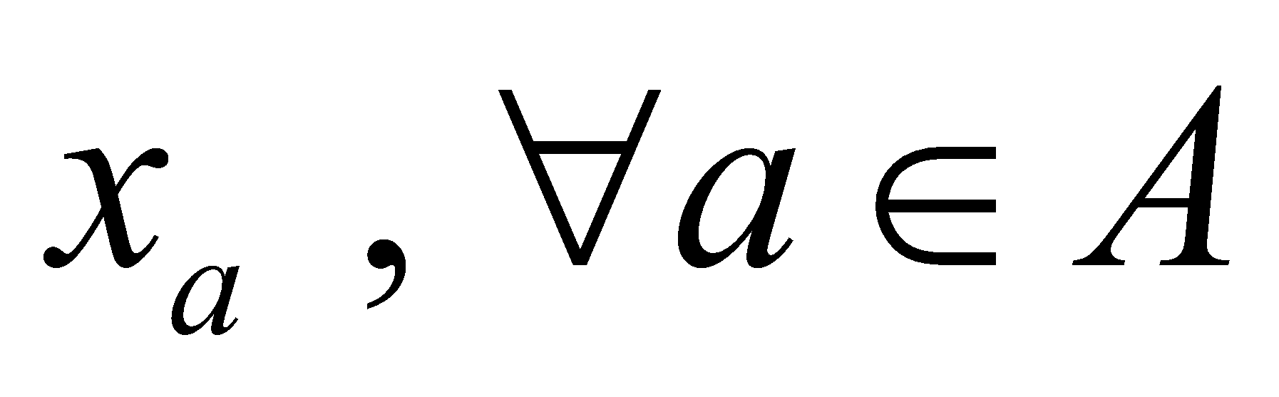
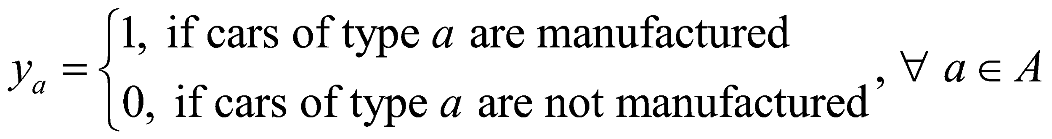
Organizing information – variables
Number of cars of each type manufactured
Binary variable – are cars of type a manufactured or not?

Slide 9
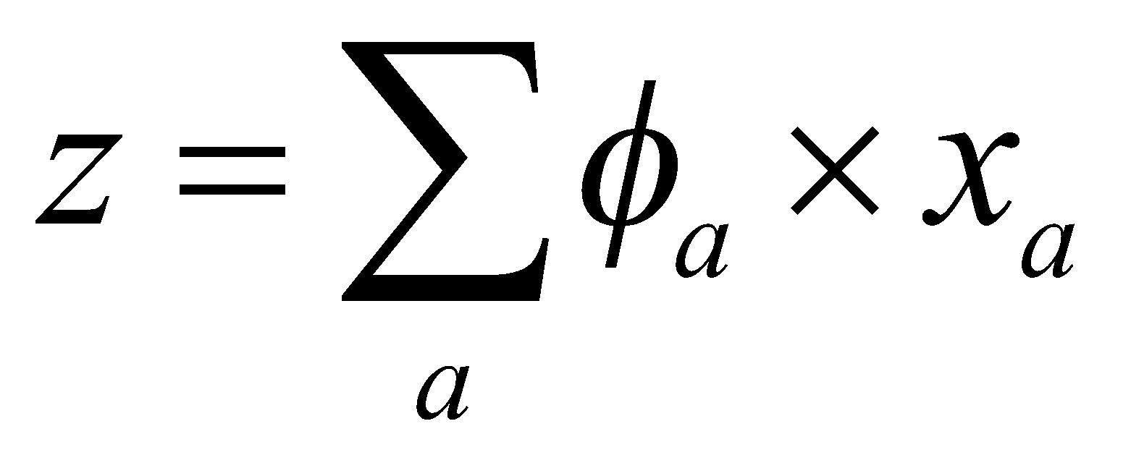
Organizing information – objective function
Maximize: total profit from manufacturing cars
Objective function:

Slide 10
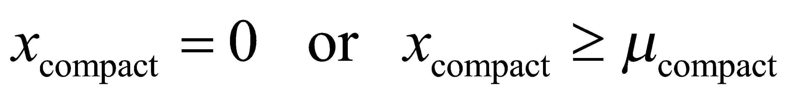
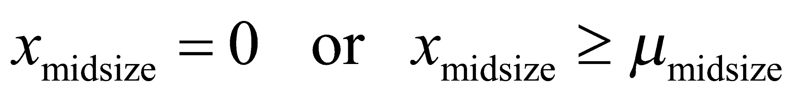
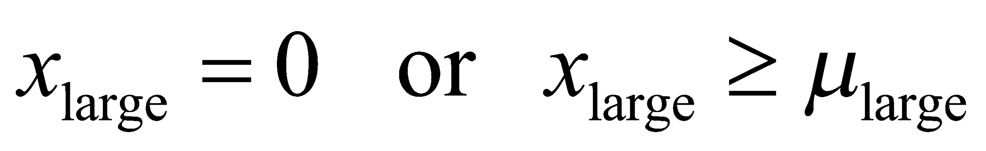
Organizing information – constraints (1)
If cars of type a are produced, at least 1000 of them must be manufactured
These are ‘either-or’ constraints

Slide 11
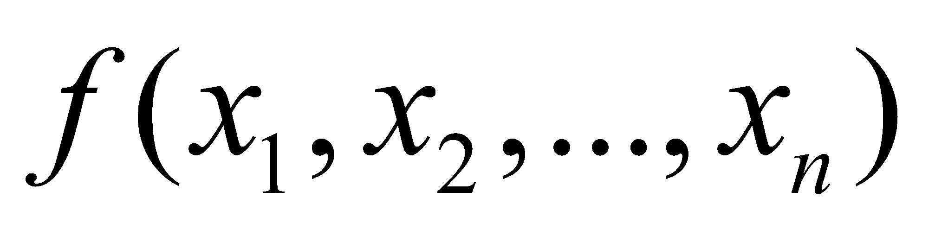
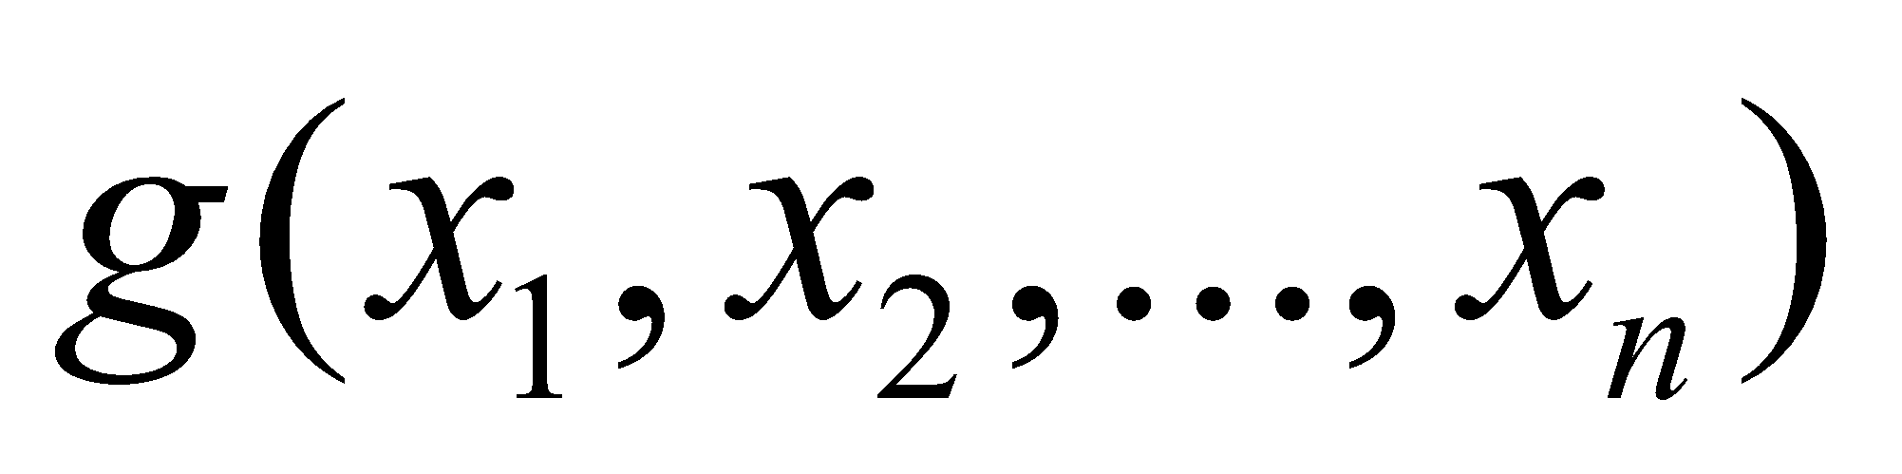
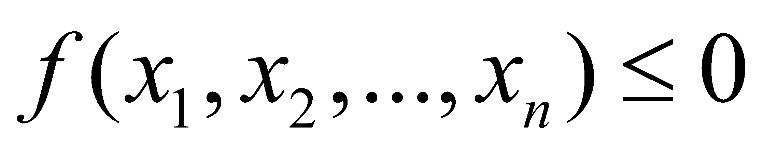
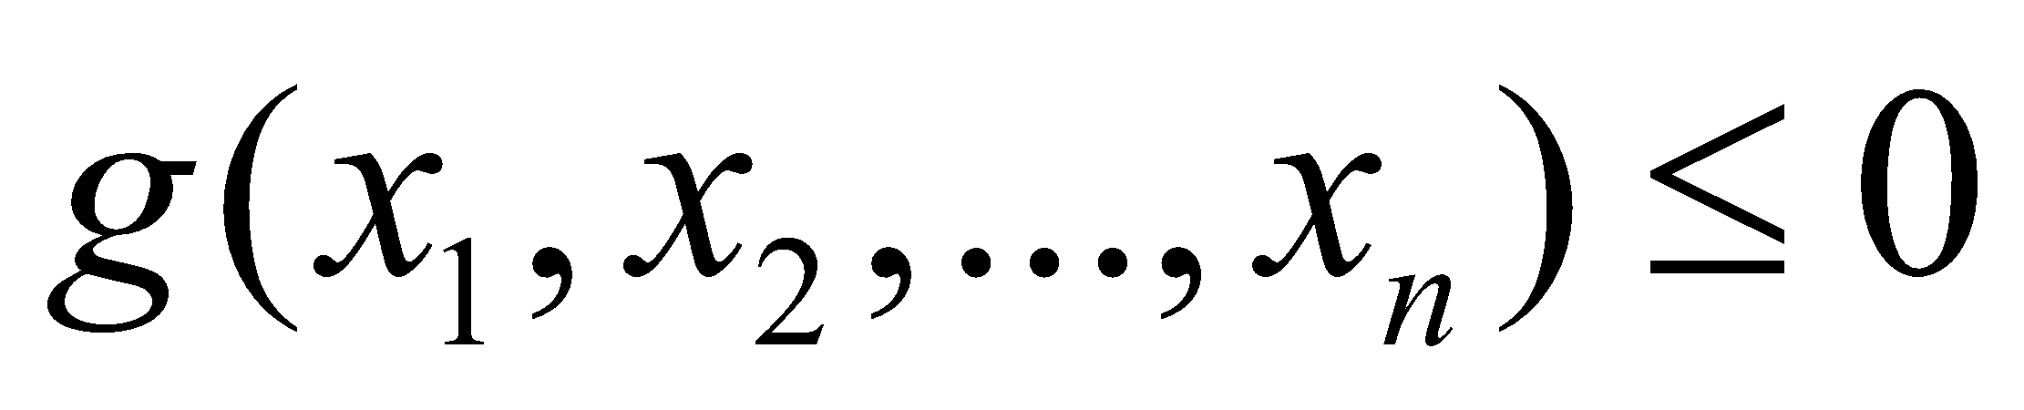
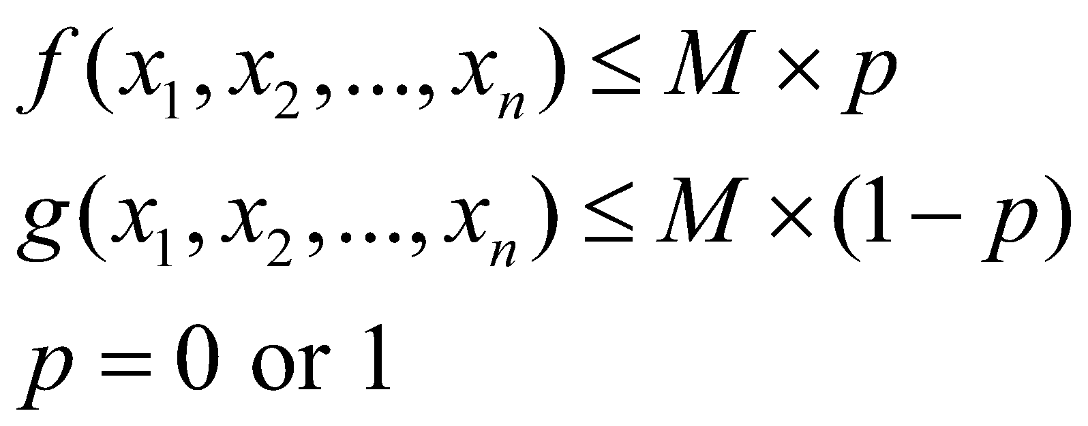
Formulating either-or constraints
Consider two constraints represented by and
Either or must be active constraints
Introduce a binary variable p to formulate an equivalent set of constraints
Here, M is called the ‘big-M’ parameter
M must be chosen to be a large enough value such that neither
nor exceed it

Slide 12
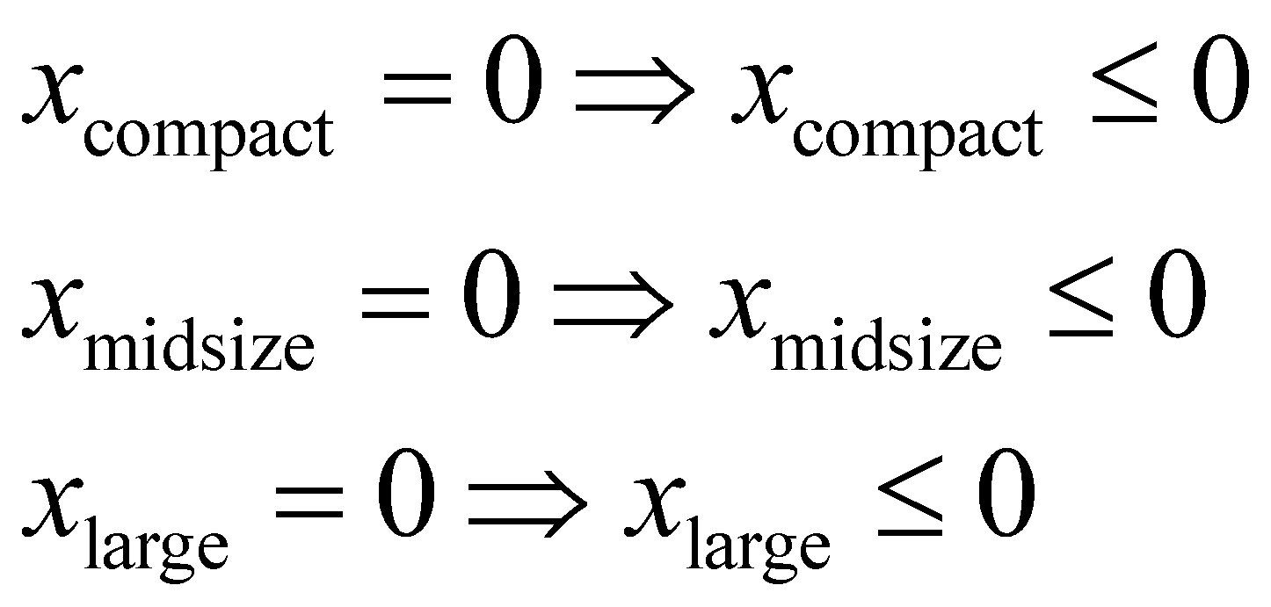
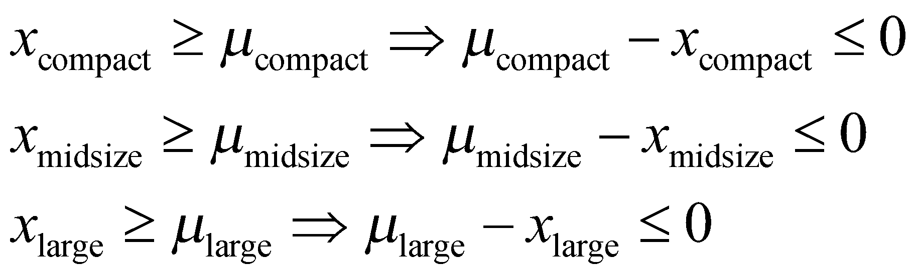
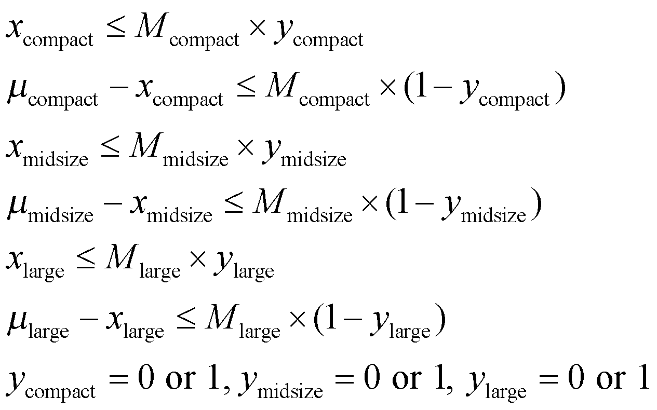
Organizing information – constraints (2)
Converting the equality constraints into inequality
If cars of type a are produced, at least 1000 of them must be manufactured

Slide 13
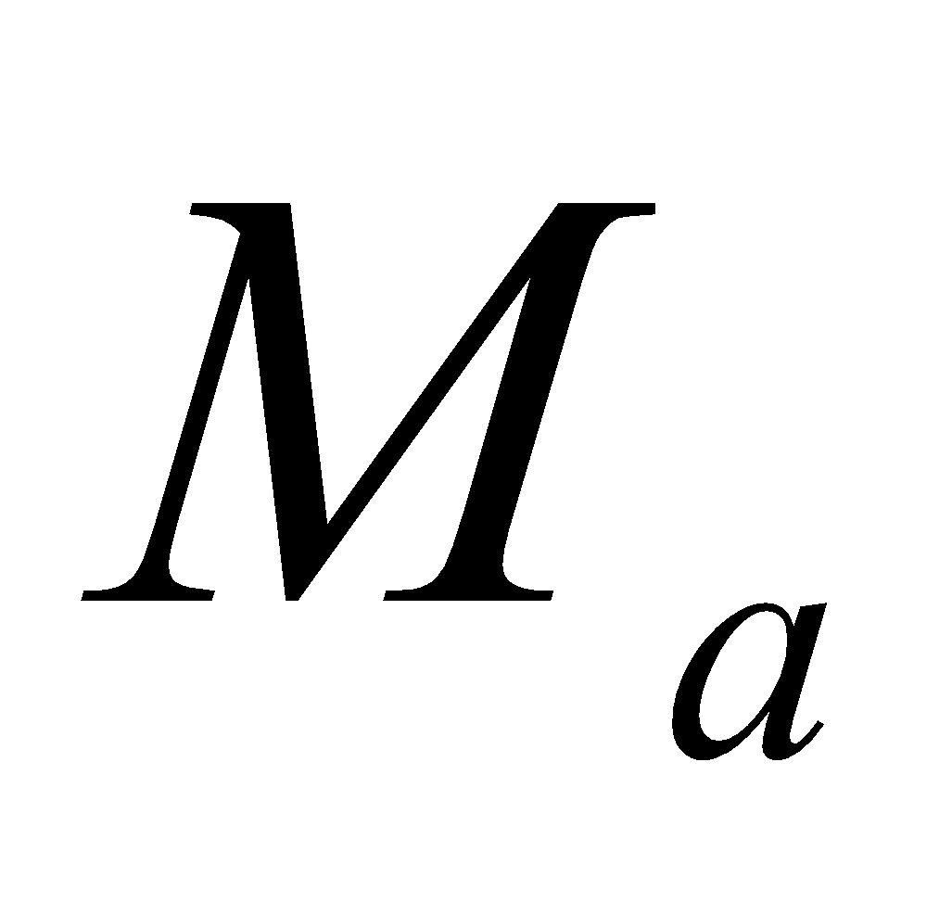
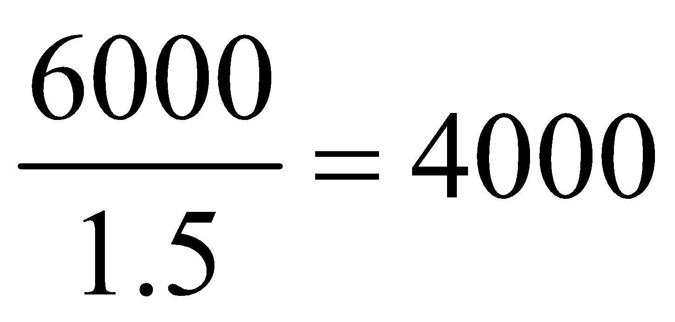
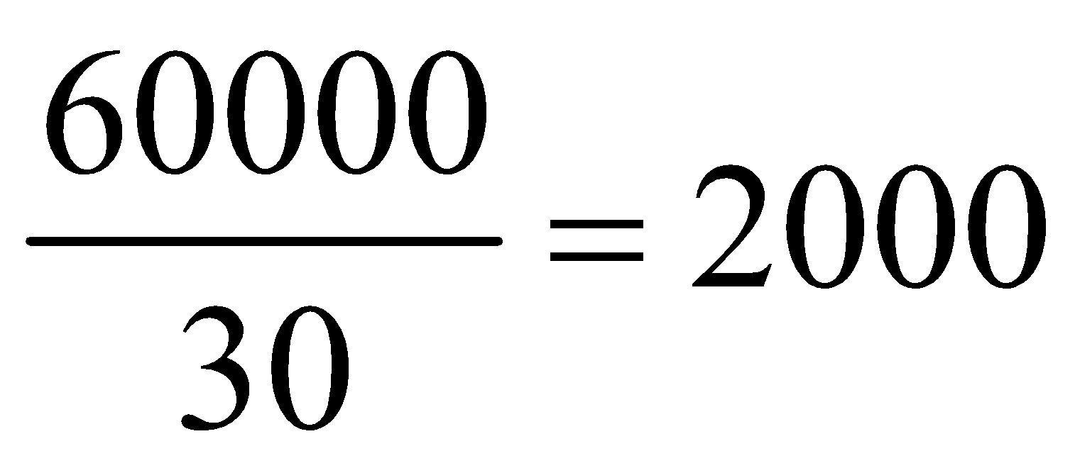
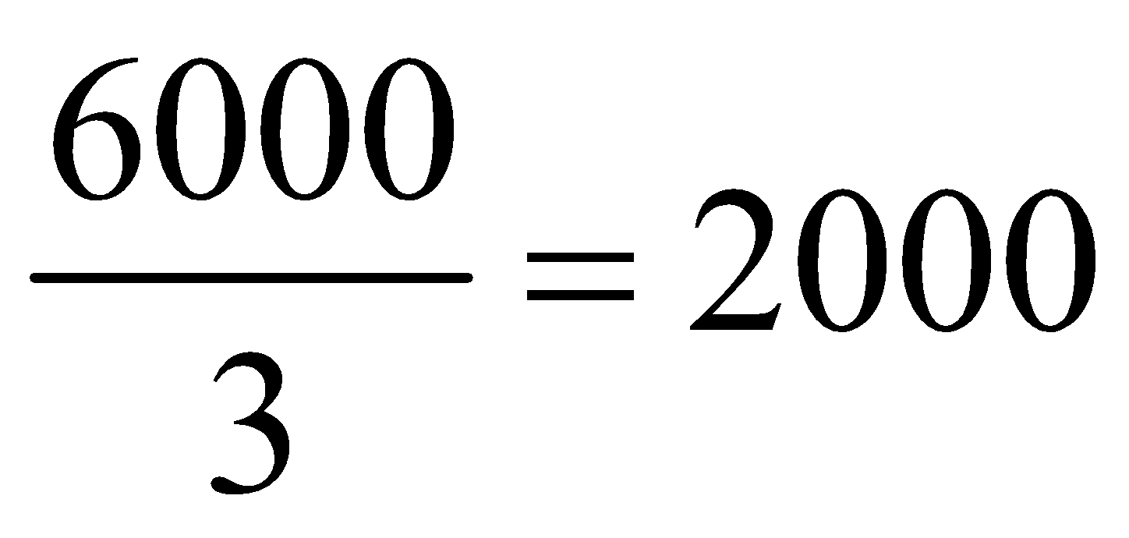
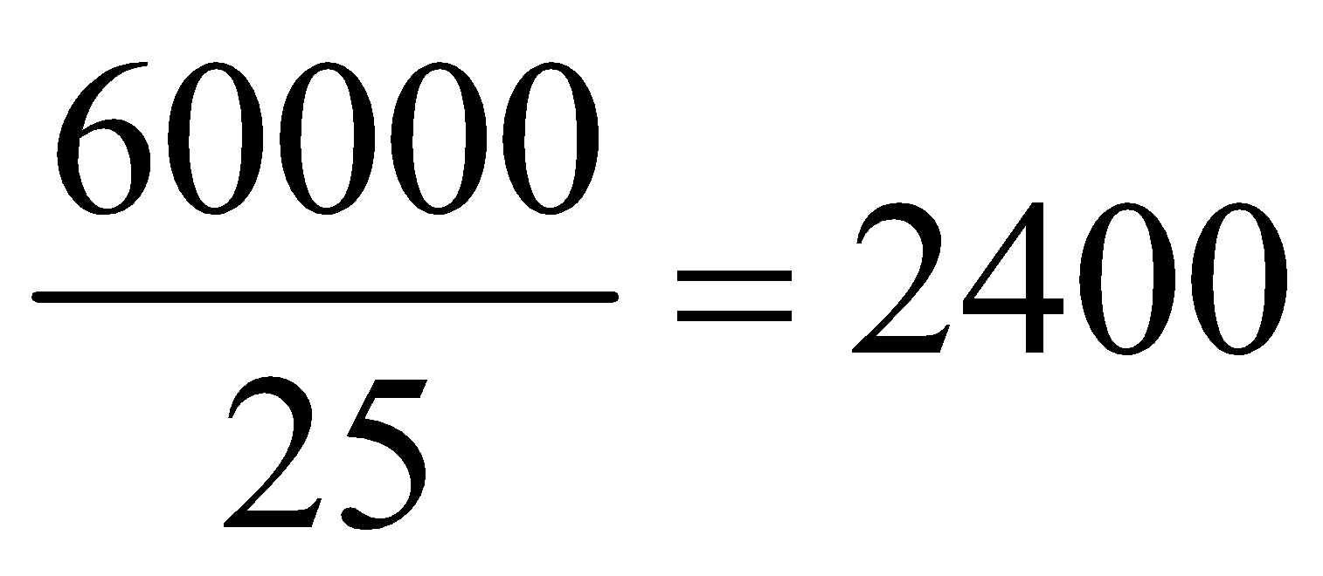
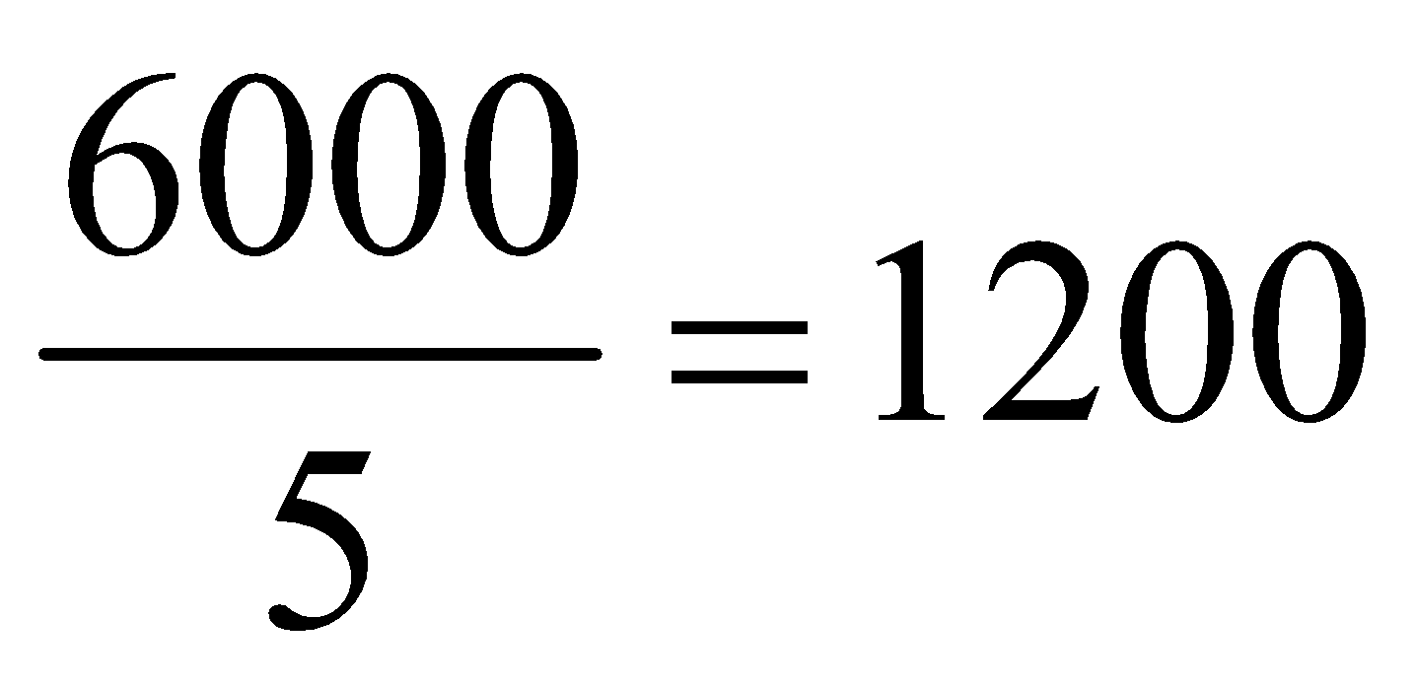
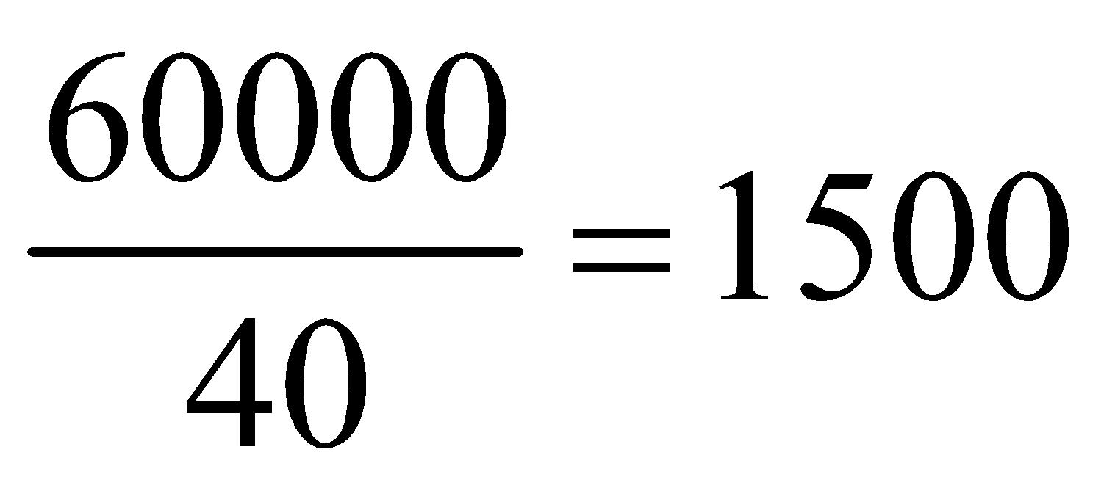
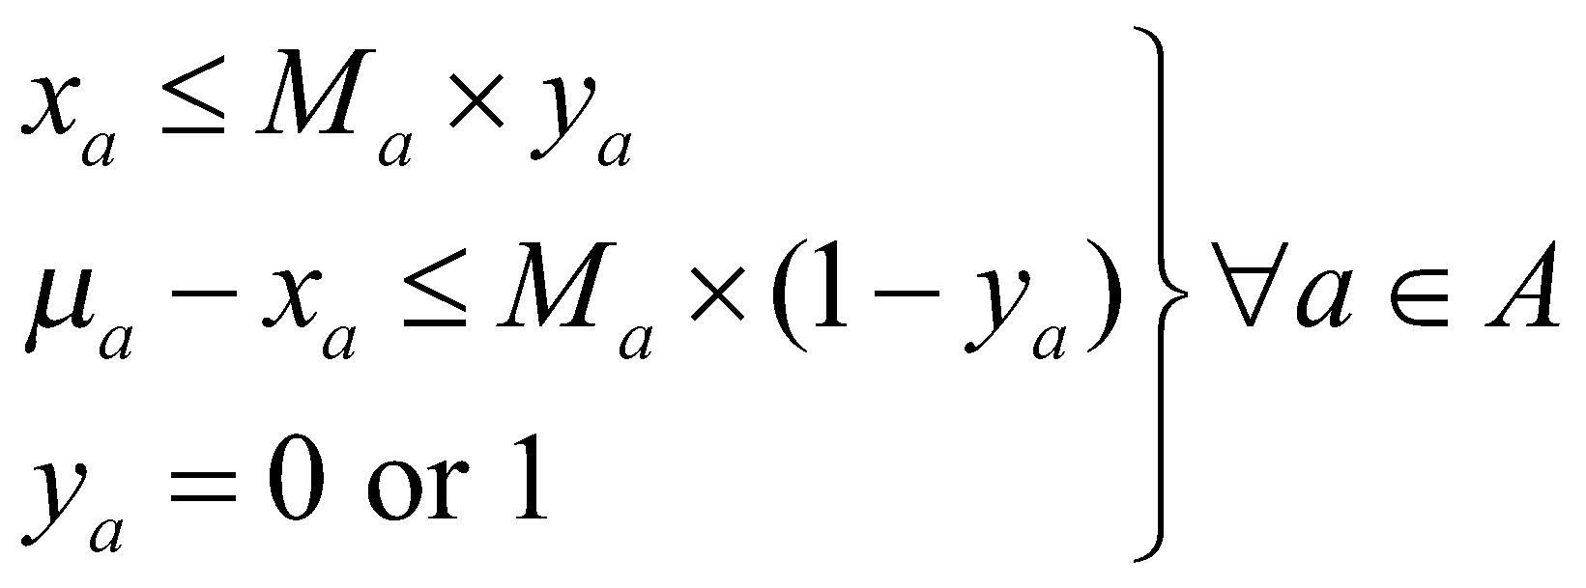
Organizing information – constraints (3)
Calculating
Generalizing the constraint
type | If all steel used on a single type | If all hours spent on a single type | M
Compact |  |  | 2000
Midsize |  |  | 2000
Large |  |  | 1200
(eq1)
(eq2)

Slide 14
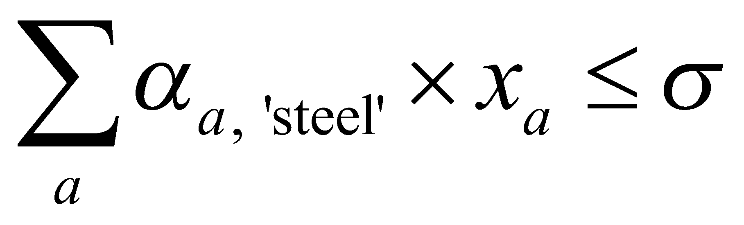
Organizing information – constraints (4)
Total steel requirement should not exceed available amount
(eq3)
Total labor requirement should not exceed available amount
(eq4)

Slide 15
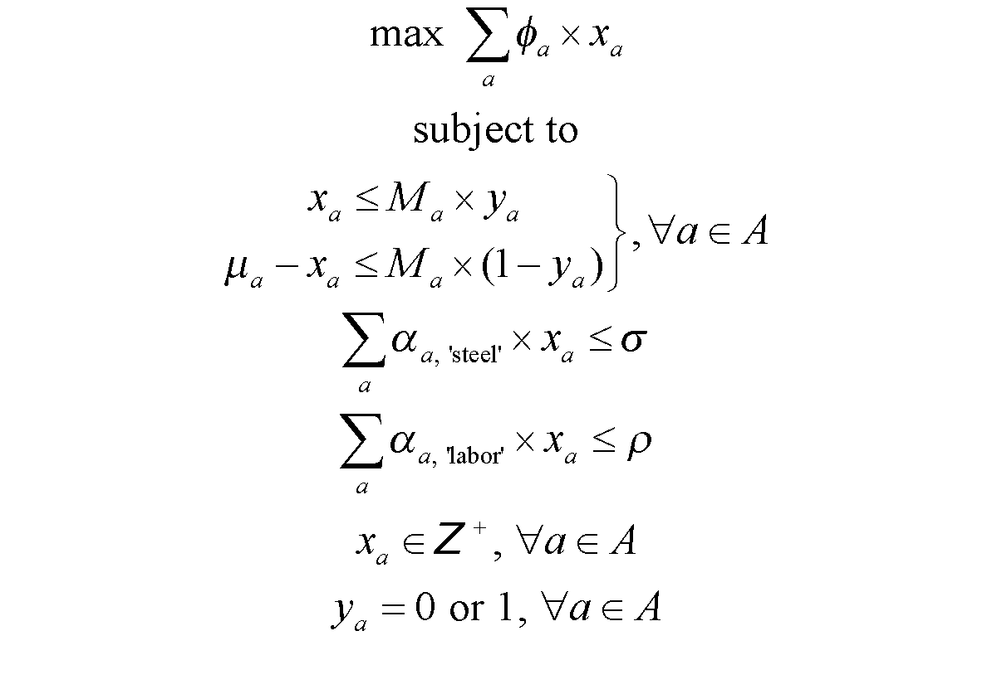
Assembling optimization model
(eq1)
(eq2)
(eq3)
(eq4)

Slide 16
Example 2* - Power generation scheduling (1)
A number of power stations are committed to meeting the defined electricity load demands over a day. There are 3 types of generating units available, 12 of type 1, 10 of type 2, and 5 of type 3. In addition to meeting the estimated load demands, there must be sufficient generators working at any time to make it possible to meet an increase in load of up to 15%. This increase would have to be accomplished by adjusting the output generators already operating within their permitted limits.
Which generators should be working in which periods of the day to minimized total cost?

Slide 17
Example 2 - Power generation scheduling (2)
Generator | Generation data
 | Minimum level (MW) | Maximum level (MW) | Cost per hour at minimum (£/hr) | Cost per hour per MW above minimum (£/hr/MW) | Cost (£) | Number of availabilities
G1 | 850 | 2000 | 1000 | 2.0 | 2000 | 12
G2 | 1250 | 1750 | 2600 | 1.3 | 1000 | 10
G3 | 1500 | 4000 | 3000 | 3.0 | 500 | 5
Time period | Demand (MW)
12 am – 6 am | 15,000
6 am – 9 am | 30,000
9 am – 3 pm | 25,000
3 pm – 6 pm | 40,000
6 pm – 12 am | 27,000

Slide 18
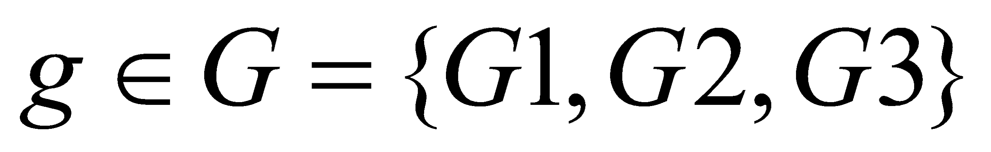
Organizing information – sets
Set of time periods in a day
Set of generators

Slide 19
Organizing information – parameters (1)
δ_{t} is the demand during each time period t (in MW)
Time period | δ_{t} (MW)
12 am – 6 am | 15,000
6 am – 9 am | 30,000
9 am – 3 pm | 25,000
3 pm – 6 pm | 40,000
6 pm – 12 am | 27,000

Slide 20
Organizing information – parameters (2)
α_{g, *} is the generation data
α_{g, min_pow} is the minimum power generated by type g (in MW)
α_{g, max_pow} is the maximum power generated by type g (in MW)
α_{g, min_cost} is the cost per hour at minimum power (in £/hr)
α_{g, inc_cost} is the cost incurred per MW above the minimum (in £/hr/MW)
α_{g, start} is the cost associated with the startup of each generator g (in £)
α_{g, gen_lim} is the number of units of type g available
Generator | α(g,*)
 | min_pow | max_pow | min_cost | inc_cost | start | gen_lim
G1 | 850 | 2000 | 1000 | 2.0 | 2000 | 12
G2 | 1250 | 1750 | 2600 | 1.3 | 1000 | 10
G3 | 1500 | 4000 | 3000 | 3.0 | 500 | 5

Slide 21
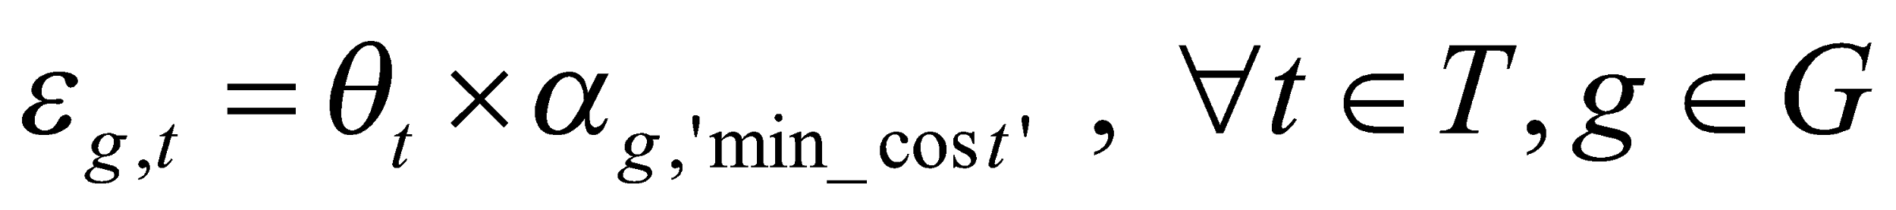
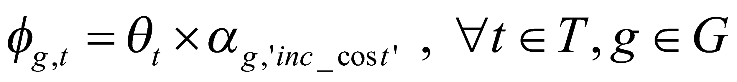
Organizing information – parameters (3)
θ_{t} is the number of hours in each time period t (in hours):
ε_{g,t} is the cost per hour for operation of generator g at minimum level multiplied by the number of hours in the period t (in £):
φ_{g,t} is the cost incurred per hour per megawatt for operation of generator g at multiplied by the number of hours in the period t (in £/MW):
Time period | θ_{t} (hr)
12 am – 6 am | 6
6 am – 9 am | 3
9 am – 3 pm | 6
3 pm – 6 pm | 3
6 pm – 12 am | 6

Slide 22
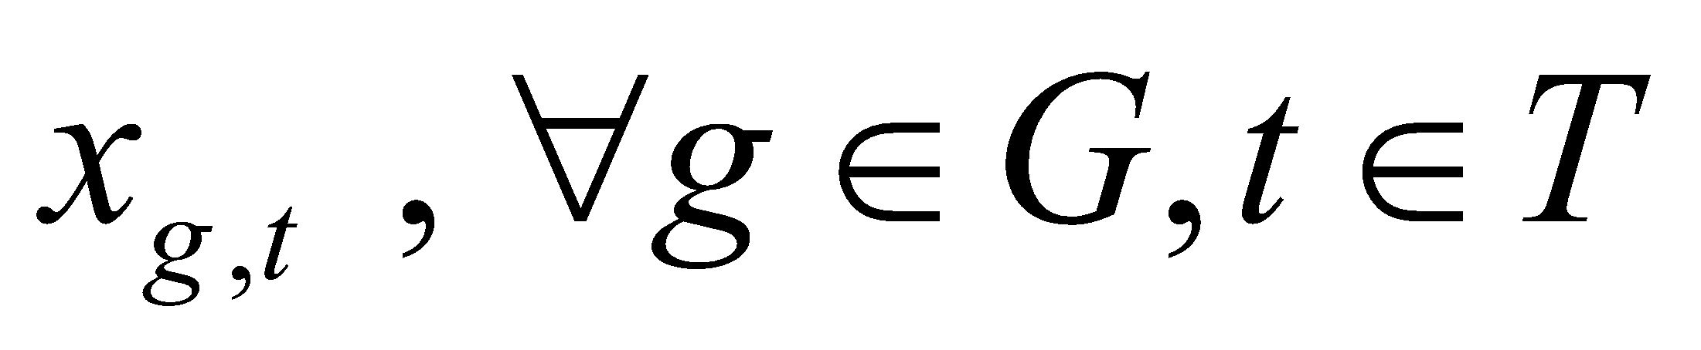
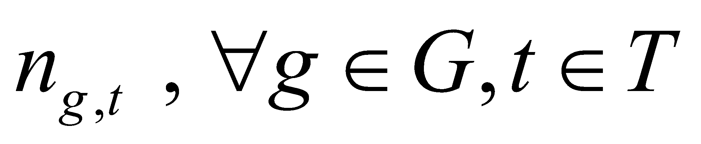
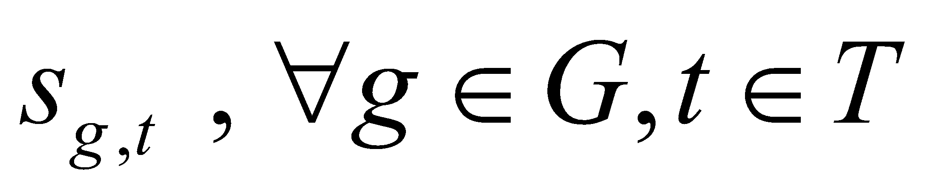
Organizing information – variables
Output of generator g during time period t (in 1000s of MW) – non-negative-continuous variable
Number of generators of type g in use during time period t – non-negative-integer variable
Number of generators of type g started up during time period t – non-negative-integer variable

Slide 23
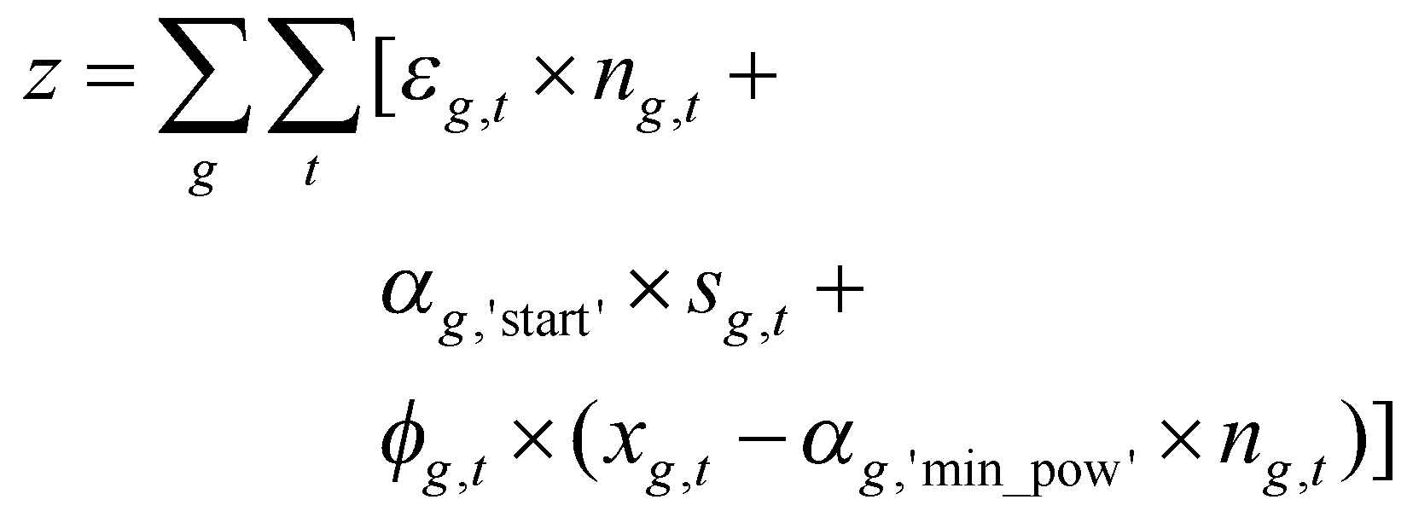
Organizing information – objective function
Minimize: total cost from meeting power demand
Total cost = Total cost of running generators at minimum power +
Total start up cost +
Total cost of running generators above minimum power
Objective function:

Slide 24
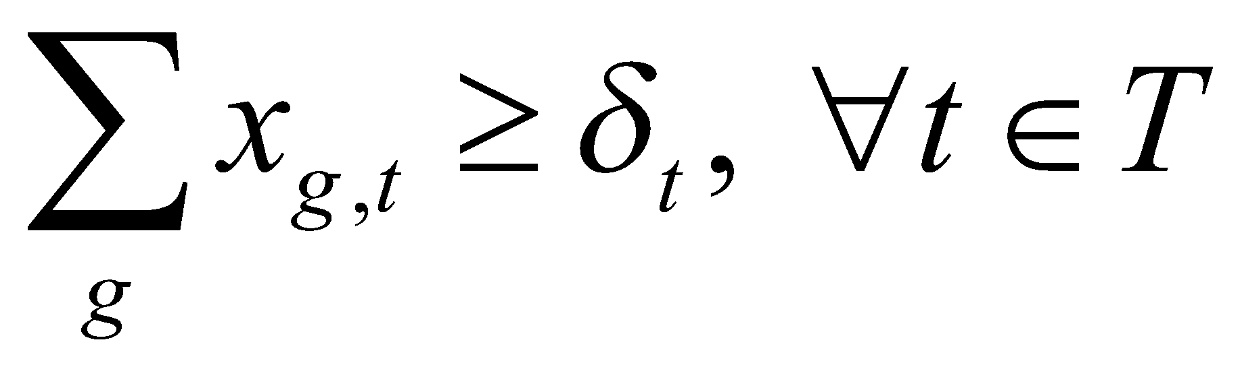
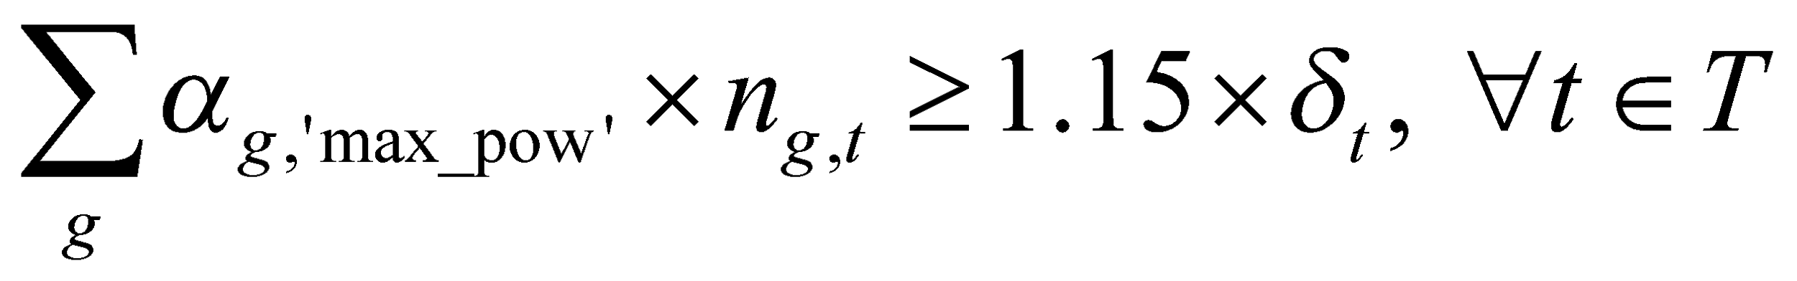
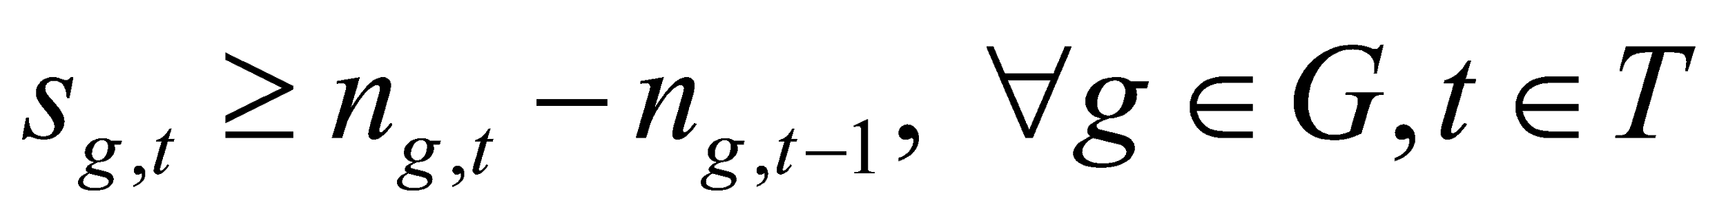
Organizing information – constraints (1)
Power demand satisfaction
Spinning reserve requirement
Start-up definition
(eq1)
(eq2)
(eq3)

Slide 25
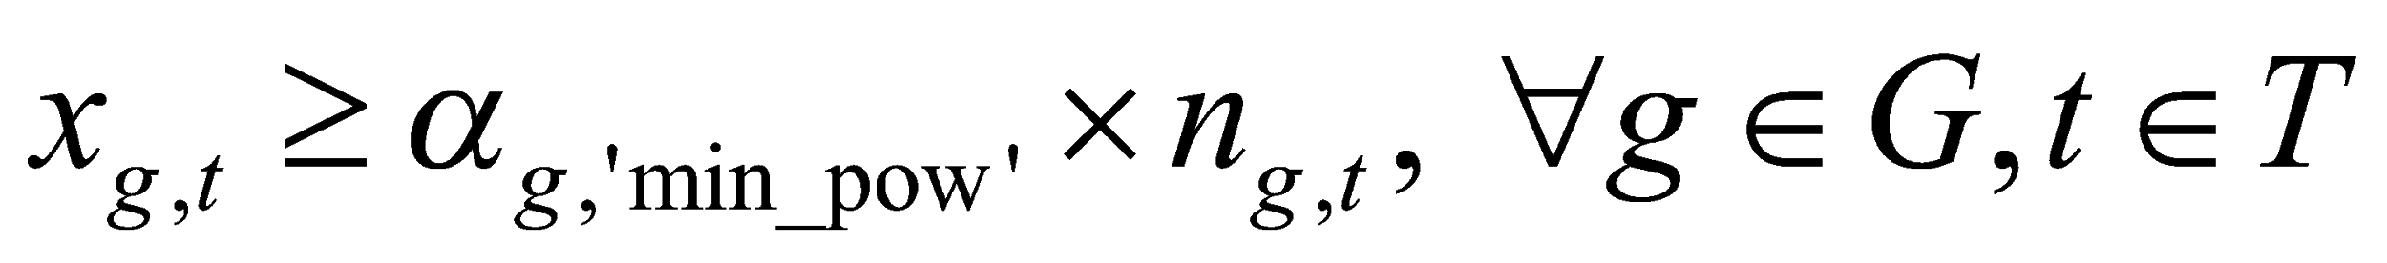
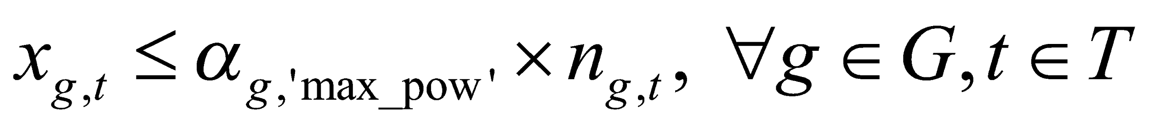
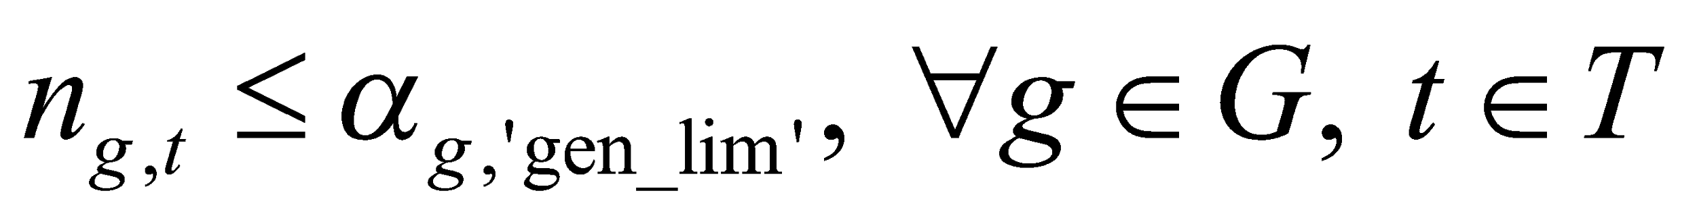
Organizing information – constraints (2)
Minimum generation levels
Maximum generation levels
Maximum number of generators
(eq4)
(eq5)
(eq6)

Slide 26
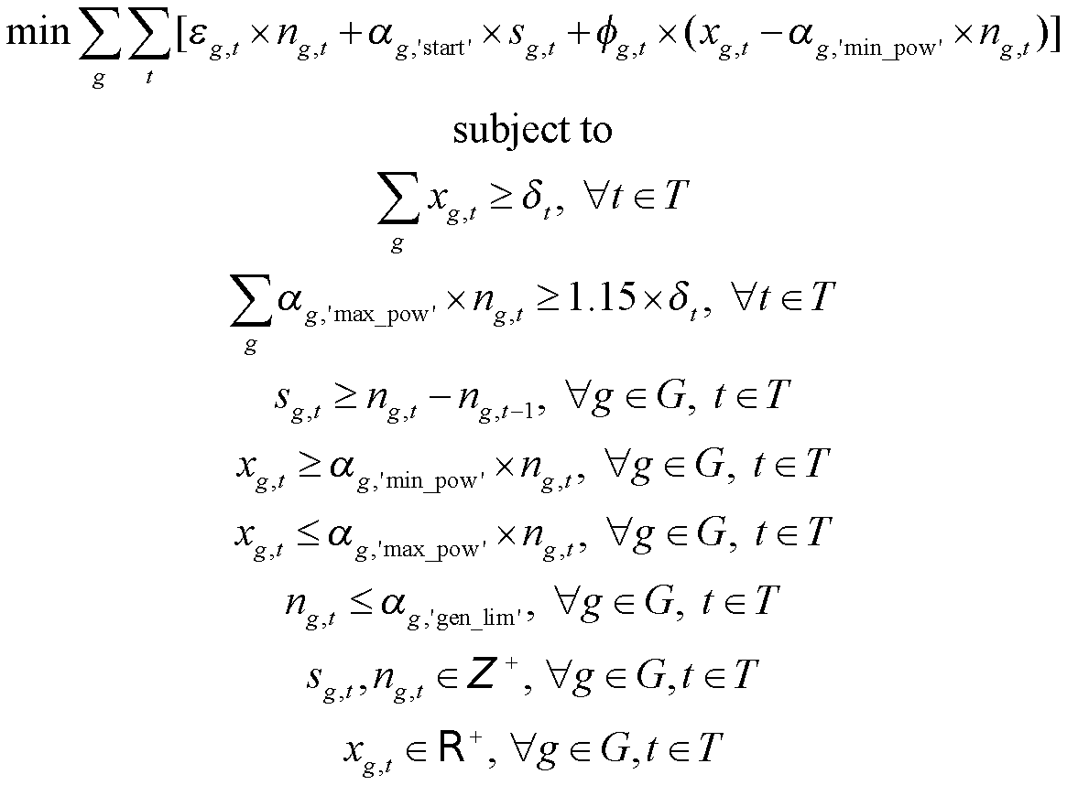
Assembling optimization model
(eq1)
(eq2)
(eq3)
(eq4)
(eq5)
(eq6)

Slide 27
Example 3* - Flow shop scheduling
A workshop that produces metal pipes on demand for the automobile industry has three machines for bending the pipes, soldering the fastenings and assembling the links. The workshop has to produce 6 pieces. Every workpiece first goes to bending, then to soldering, and finally to the assembly of the links. Once started, any operations must be carried out without interruption, but the workpieces may wait between the machines. Every machine only processes one piece at a time. A workpiece may not overtake any other by passing onto the following machine. This means that if, at the beginning, a sequence of the workpieces is established, they will be processed on every machine in exactly this order. Which is the sequence of workpieces that minimizes the total time for completing all pieces?

Slide 28
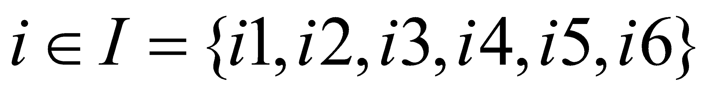
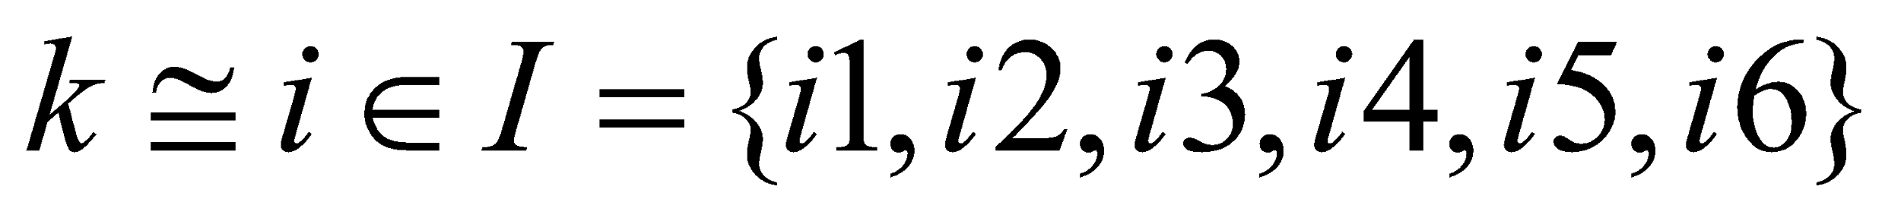
Organizing information – sets
Set of all workpieces to be worked upon
Set of all machines
(Alias) set of items

Slide 29
Organizing information – parameters
τ_{m,i} is the processing time (in hours) associated with each machine m for each workpiece i
Machines | Workpieces
 | i1 | i2 | i3 | i4 | i5 | i6
bending | 3 | 6 | 3 | 5 | 5 | 7
soldering | 5 | 4 | 2 | 4 | 4 | 5
assembly | 5 | 2 | 4 | 6 | 3 | 6

Slide 30
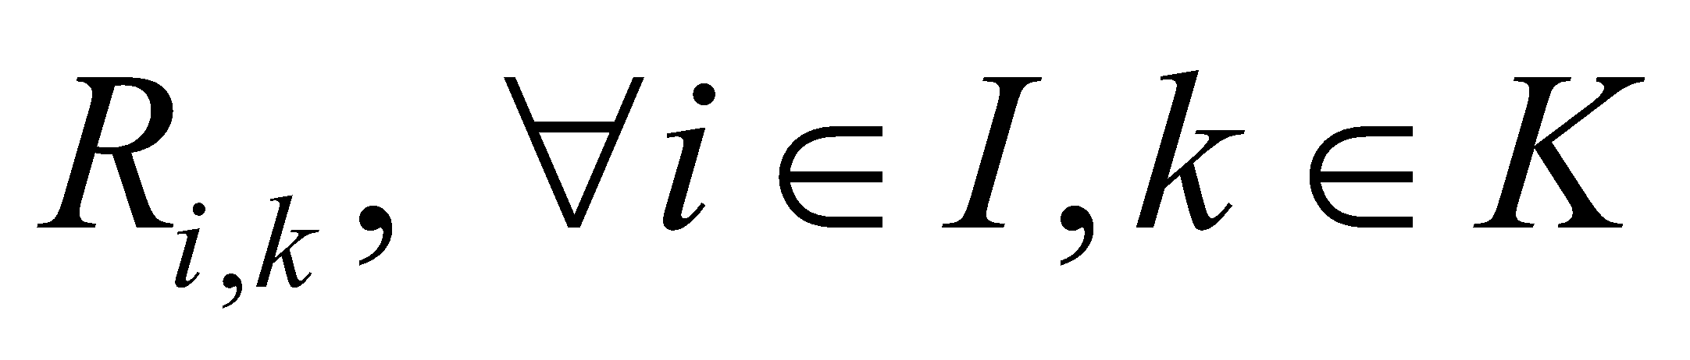
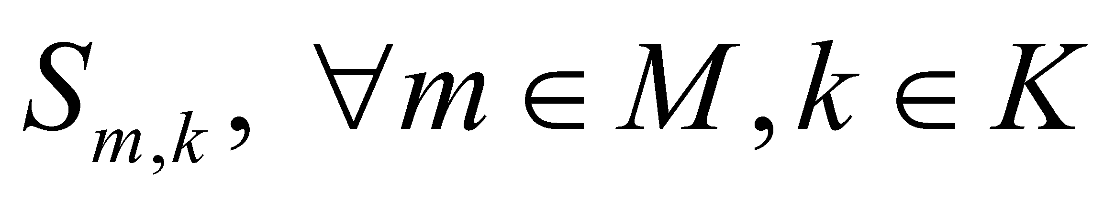
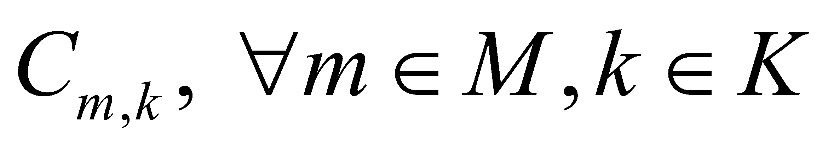

Organizing information – variables
Rank of item i is position k
Start time for job in position k on machine m
Completion time for job in position k on machine m
Completion time of the final ranked job on the last machine

Slide 31

Organizing information – objective function
Minimize: total processing time, or the completion time of final ranked job on last machine
Objective function:

Slide 32
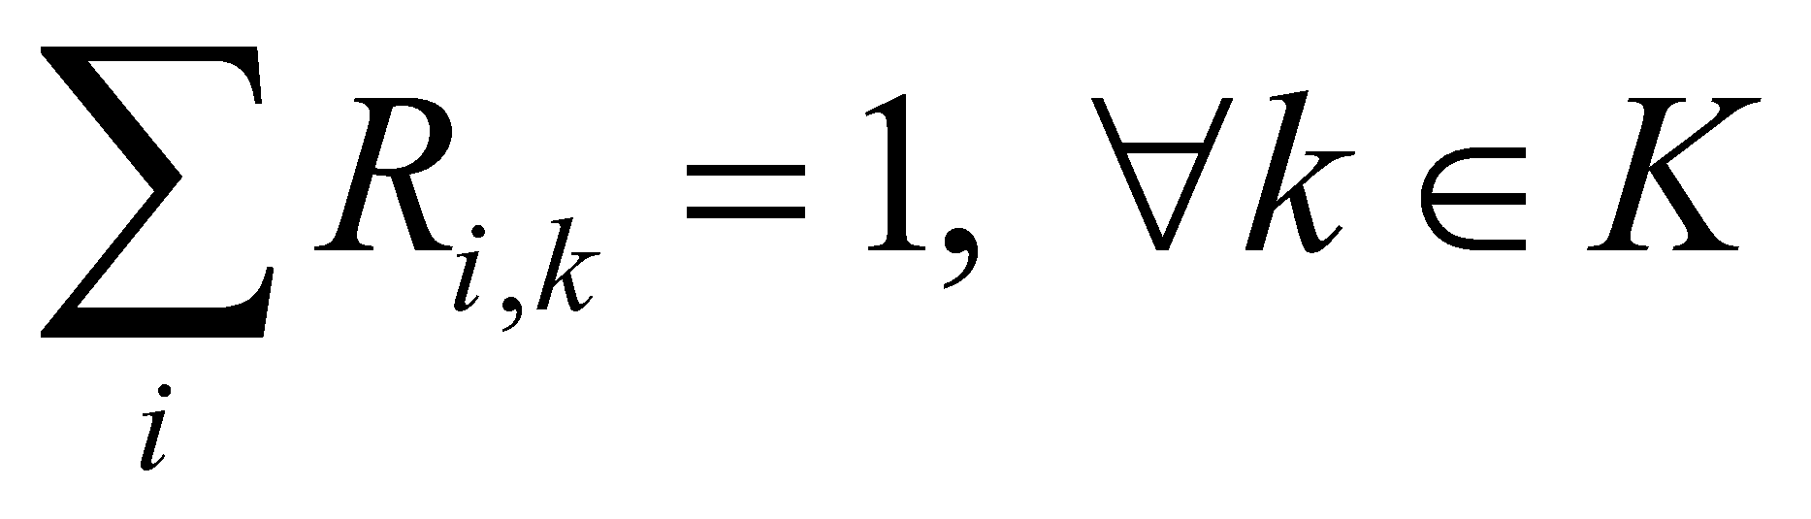
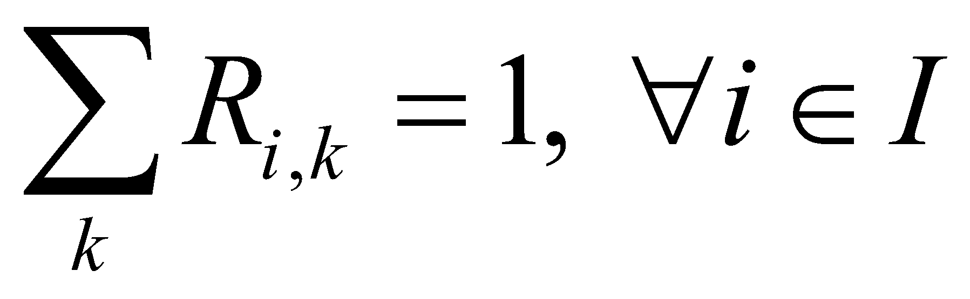
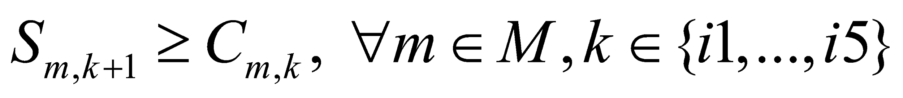
Organizing information – constraints (1)
Every position gets a job
Every job is assigned a rank
Relations between the end of job ranked k, and start of job ranked k + 1 on machine m
(eq1)
(eq2)
(eq3)

Slide 33
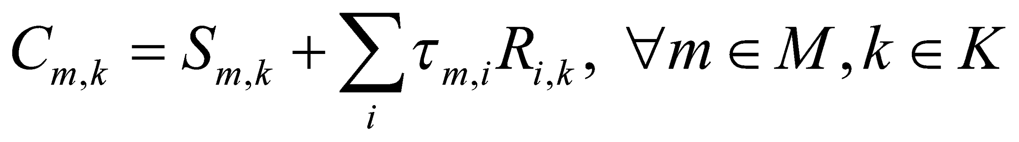
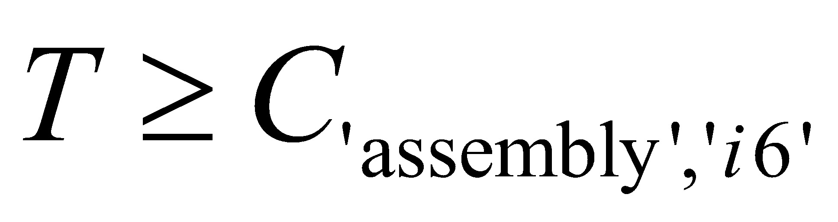
Organizing information – constraints (2)
Relations between the end of job ranked k on machine m, and start of job ranked k on machine m+1
Calculation of completion time based on start time and processing time
Completion time of job ranked last
(eq4)
(eq5)
(eq6)

Slide 34
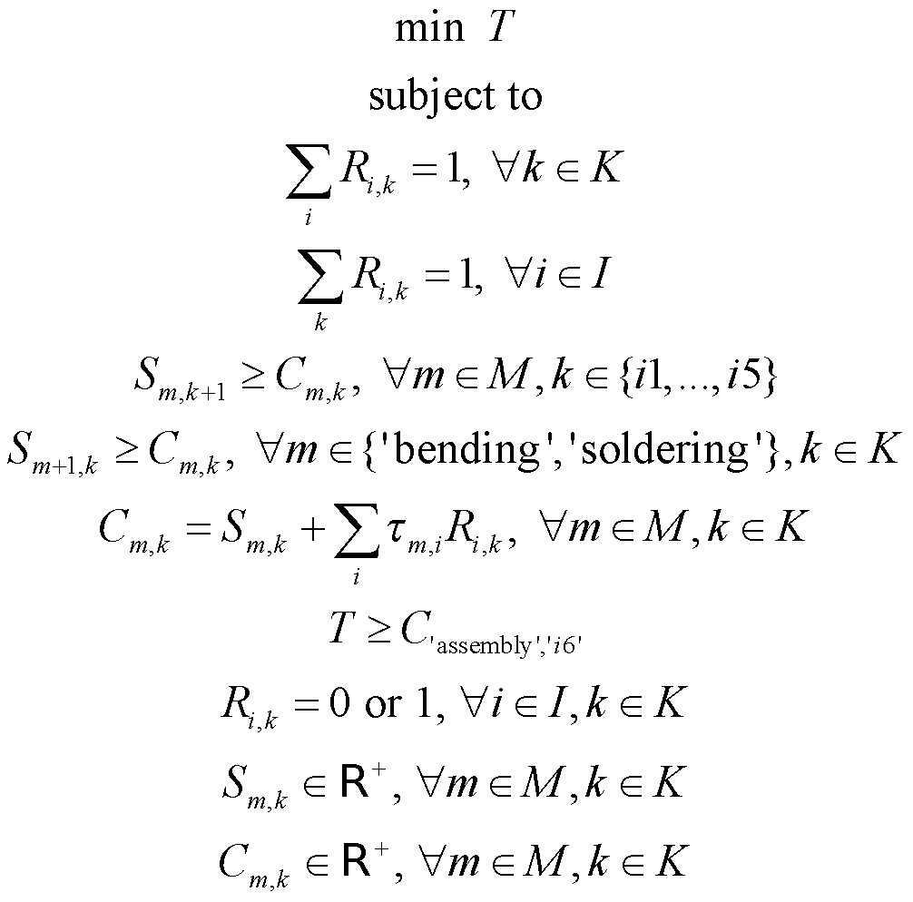
Assembling optimization model
(eq1)
(eq2)
(eq3)
(eq4)
(eq5)
(eq6)

Slide 35
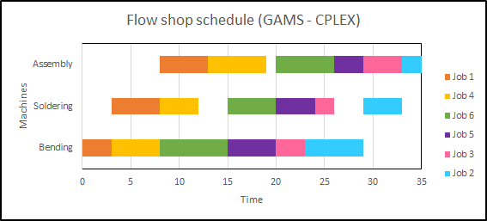
Example 3 – results (GAMS)
Solver: CPLEX
T = 35 minutes

Slide 36

Example 3 – results (GAMS)
Solver: CBC
T = 35 minutes

Slide 37

Example 3 – results (Pyomo)
Solver: CPLEX
T = 35 minutes

Slide 38

Example 3 – results (Pyomo)
Solver: CBC
T = 35 minutes

Slide 39
Summary
In this section, we learnt
The general structure of a mixed integer linear optimization problem
Introduction to coding simple MILP models in GAMS and Pyomo
Defining “either-or” constraints using big-M
Exporting data from Pyomo and GAMS
Accessing elements dynamically in GAMS and Pyomo
Submitting jobs on NEOS (for GAMS and Pyomo platforms)
Visualizing results for scheduling problems

